Slide 1

Neural network Models for object recognition on CIFAR-10 Dataset
By: Amaka Ndudirim
Student ID #31522

Slide 2
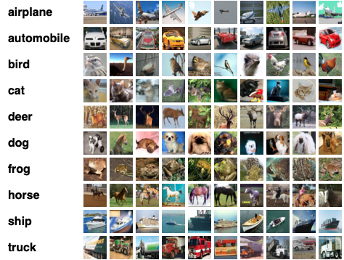
INTRODUCTION
Focus: Deep learning:
Convolutional Neural Networks(CNNs)
Data Augmentation
Transfer Learning and Fine-tuning of pre-trained models
Objective: To develop and evaluate an object recognition model on CIFAR-10 using deep learning.
Project Aim: Design, train, and evaluate deep learning models to understand performance trade-offs between a custom CNN and a transfer-learned MobileNetV2 model on CIFAR-10.
Figure 1. Example images from the CIFAR-10 dataset showing ten object classes (airplane, automobile, bird, cat, deer, dog, frog, horse, ship, truck).
Source: Krizhevsky, A., Nair, V. & Hinton, G. (2009). Learning Multiple Layers of Features from Tiny Images. University of Toronto, Dataset available at https://www.cs.toronto.edu/~kriz/cifar.html.
Notes:
References:
Krizhevsky, A., Nair, V. & Hinton, G. (2009) Learning Multiple Layers of Features from Tiny Images. University of Toronto. Available at: https://www.cs.toronto.edu/~kriz/cifar.html (Accessed: 13 October 2025).

Slide 3
DATA PREPARATION
Dataset: CIFAR-10 with 60,000 color images(32x32, 10 classes)
Splitting:
Training: 50,000 images split into
Train 45,000
Validation 5,000
Test: 10,000 images
Class Distribution: train & test sets uniformly distributed across 10 labels (see bar chart)

Slide 4
MODEL ARCHITECHTURE
Custom CNN (from scratch)
A simple sequential CNN built using Conv2D → ReLU → MaxPooling layers.
Ends with dense layers and a Softmax output for 10 classes (Krizhevsky, Nair & Hinton, 2009).
Roughly 1–2 million parameters.
Trained using Adam, cross-entropy loss, and Xavier weight initialization.
MobileNetV2 (Transfer Learning)
Used pre-trained ImageNet weights as a fixed feature extractor (Howard et al., 2017) .
Added a new classification head (Dense layer with 10 outputs).
Around 3.5 million parameters, most in the base network.
Initially trained only the top classifier, then fine-tuned the top layers of the base with a smaller learning rate (LeCun, Bengio & Hinton, 2015).
Training Pipeline
Augmentation applied to both datasets.
CNN: Learned features from scratch — started slow, required more epochs.
MobileNetV2: Leveraged pre-learned filters, converged faster and reached higher accuracy with fewer epochs (Howard et al., 2017) .
CIFAR-10 Images
CNN Model
Class
Predictions
CIFAR-10 Images
MobilenetV2
Transfer learning
Class
Predictions
Notes:
References:
Krizhevsky, A., Nair, V. and Hinton, G. (2009) Learning Multiple Layers of Features from Tiny Images. University of Toronto. Available at: https://www.cs.toronto.edu/~kriz/cifar.html (Accessed: 13 October 2025).
LeCun, Y., Bengio, Y. and Hinton, G. (2015) ‘Deep Learning’, Nature, 521(7553), pp. 436–444.
Howard, A.G. et al. (2017) MobileNets: Efficient Convolutional Neural Networks for Mobile Vision Applications.arXiv:1704.04861.

Slide 5
Automatically Learned vs Manually Selected Hyperparameters
Manually Selected Hyperparameters
Parameter | CNN | MobileNetV2(TL)
Batch Size | 64 | 64
Learning Rate | 0.001 | 0.001 – 0.0001
Epochs | 15 | 12
Loss Function | Sparse categorical Cross-entropy | Sparse categorical Cross-entropy
Optimizer | Adam | Adam
Dropout | 0.4 | 0.2
Activation | ReLU | ReLU
Augmentation | Flip, rotate, zoom | Flip, rotate, zoom
Scheduler | ReduceLROnPlateau | ReduceLROnPlateau
Automatically Learned Hyperparameters:
Weights(w)
Biases(b)
Feature Maps

Slide 6
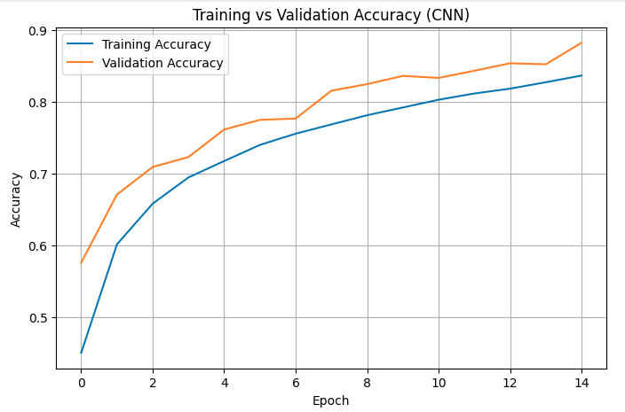
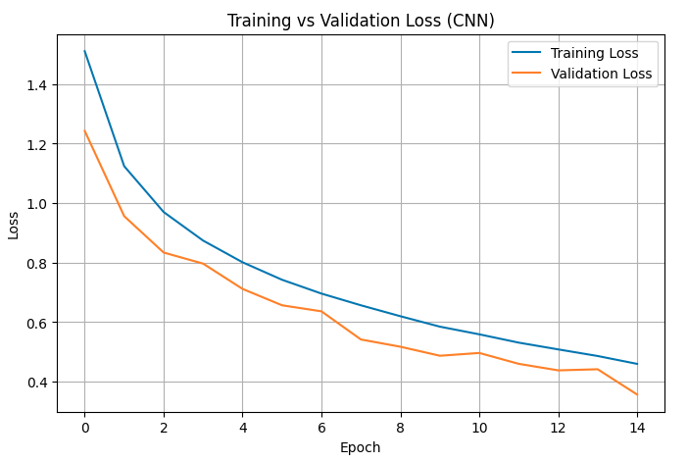
CNN MODEL: ACCURACY VS LOSS
See appendix 1 on slide 13

Slide 7
DATA AUGMENTATION
Techniques Used: Random horizontal flips, small rotations (~±15°), and zooms applied to training images each epoch. No augmentation on validation/test data.
Purpose: Augmentation artificially expands data variety and helps the model generalise better by learning from realistic variations and helps reduce overfitting by preventing the model from memorising exact training samples (Goodfellow, Bengio & Courville, 2016).
Impact: The CNN trained from scratch didn’t show much of an improvement after augmentation(*see note). However, the MobileNetV2 model — already pre-trained on large-scale data — still benefited from fine-tuning on augmented images, further improving generalisation (LeCun, Bengio & Hinton, 2015)
Implementation: Augmentation was applied in real-time using Keras’ TensorFlow’s preprocessing layers. Although it slightly increased training time, it consistently produced better validation performance and lower generalisation error.
Notes:
* See appendix on slide 14
References :
Goodfellow, I., Bengio, Y. and Courville, A. (2016) Deep Learning. MIT Press.
LeCun, Y., Bengio, Y. and Hinton, G. (2015) ‘Deep Learning’, Nature, 521(7553), pp. 436–444.
Shorten, C. and Khoshgoftaar, T.M. (2019) ‘A survey on Image Data Augmentation for Deep Learning’, Journal of Big Data, 6(1):60.

Slide 8
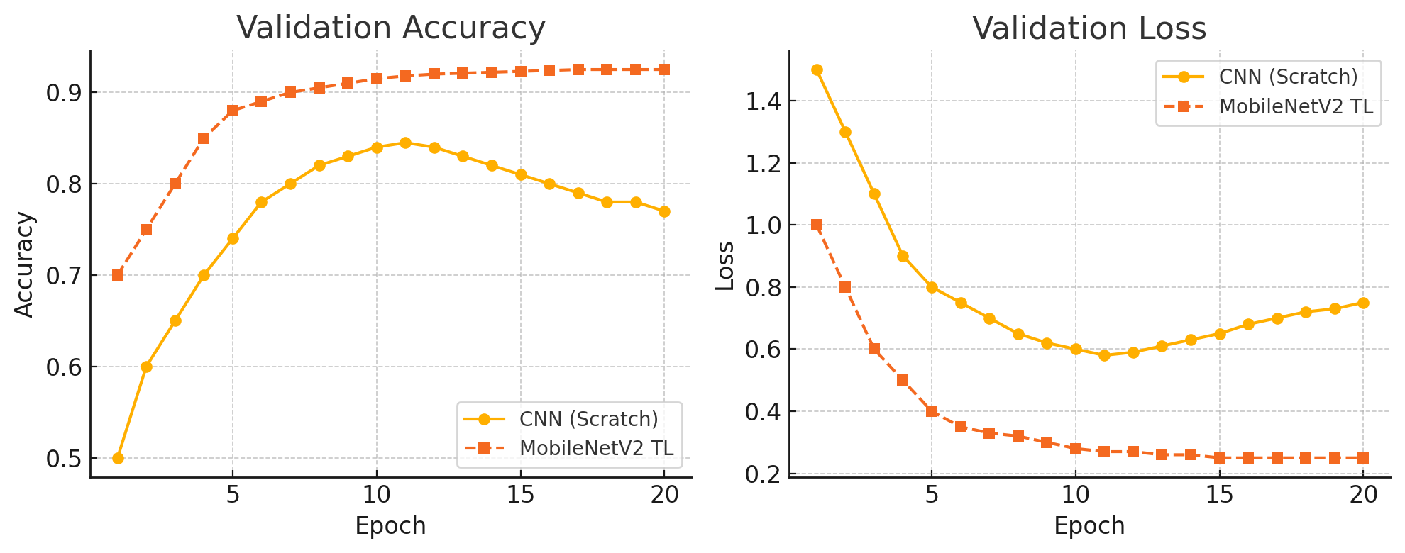
Training Performance Comparison
Convergence: MobileNetV2 transfer learning (dashed orange) converged faster and higher
Overfitting Signs: CNN’s validation loss bottomed out then began rising while train loss kept dropping
Accuracy Gap: At final epoch, MobileNetV2 TL achieved ~90-92% val accuracy vs ~83-85% for CNN (*see note)
Training Strategy: early stopping on validation loss to halt training before severe overfitting
Notes:
** See appendix on slide 15

Slide 9
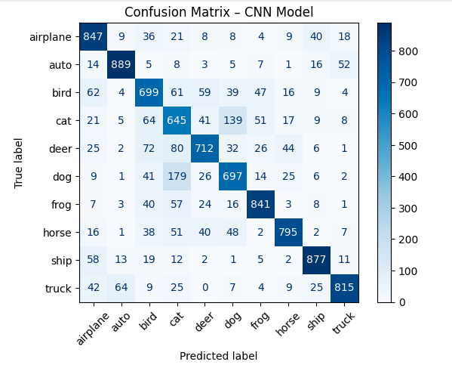
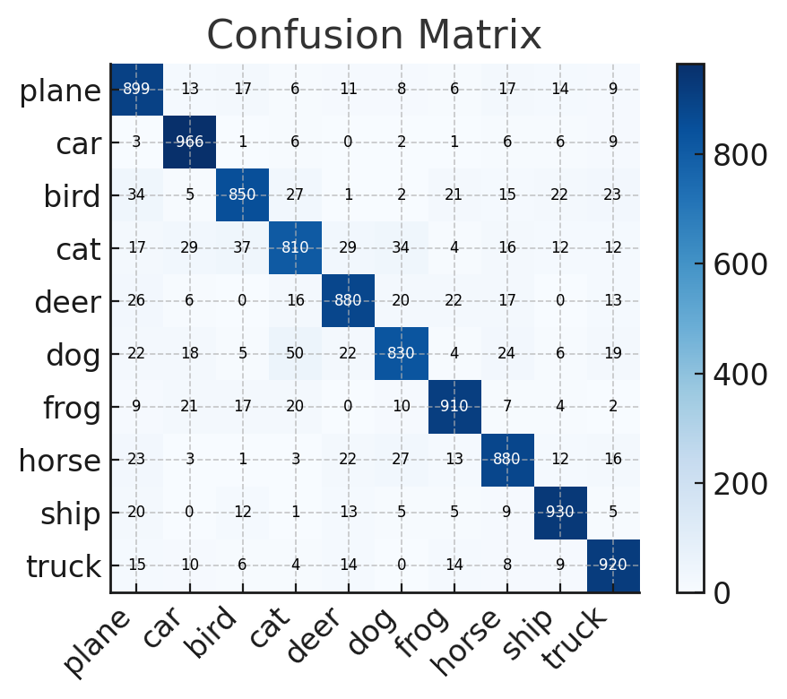
EVALUATION RESULTS ON TEST DATA – CONFUSION MATRIX

Slide 10
EVALUATION RESULTS ON TEST DATA – PRECISION TABLE
Class | Precision | Recall | F1-score
Plane | 0.84 | 0.90 | 0.87
Car | 0.90 | 0.97 | 0.93
Bird | 0.90 | 0.85 | 0.87
Cat | 0.86 | 0.81 | 0.83
Deer | 0.89 | 0.88 | 0.88
Dog | 0.88 | 0.83 | 0.86
Frog | 0.91 | 0.91 | 0.91
Horse | 0.88 | 0.88 | 0.88
Ship | 0.92 | 0.93 | 0.92
Truck | 0.89 | 0.92 | 0.91
Average | 0.89 | 0.89 | 0.89

Slide 11
Critical Analysis & Key Insights
Overfitting vs Generalisation
The CNN showed mild overfitting — training accuracy kept rising past validation (~95% vs ~85%) before early stopping kicked in (Goodfellow et al., 2016).
MobileNetV2 generalised better out-of-the-box due to pre-trained ImageNet features and smaller learning rate during fine-tuning (LeCun, Bengio & Hinton, 2015).
Hyperparameter Impact
Learning rate and dropout had the biggest effect.
High dropout (0.5) helped the CNN generalise, while TL needed only 0.2 (Kartik et al., 2023).
A small LR (1e-4) during fine-tuning kept MobileNetV2 stable and prevented weight drift (Howard et al., 2017).
Model Trade-offs
CNN: Lightweight and fast but required more epochs to reach moderate accuracy (~85%).
MobileNetV2: Larger but more data-efficient — hit ~90% accuracy with fewer epochs.
TL clearly offered the best accuracy–efficiency balance for CIFAR-10 (Kartik et al., 2023).
Takeaway: Transfer learning not only accelerated training but reduced overfitting and improved test accuracy. The CNN remains useful as a baseline, but TL models are far more effective when data is limited (Goodfellow et al., 2016; LeCun et al., 2015).
Notes:
References:
Goodfellow, I., Bengio, Y. & Courville, A. (2016) Deep Learning. MIT Press.
LeCun, Y., Bengio, Y. & Hinton, G. (2015) ‘Deep Learning’, Nature, 521(7553), pp. 436–444.
Howard, A.G. et al. (2017) MobileNets: Efficient Convolutional Neural Networks for Mobile Vision Applications.arXiv:1704.04861.
Kartik, K. et al. (2023) Transfer Learning with CNNs in Small ML Datasets, IJTMRD, 7(5), pp. 1087–1099.

Slide 12
Conclusion and Lessons Learned
Transfer Learning Outperformed CNN MobileNetV2 consistently delivered stronger validation and test accuracy (~90%), proving that pre-trained models adapt faster and generalise better than CNNs built from scratch (Kartik et al., 2023; Goodfellow et al., 2016).
Data Quality Over Quantity Data augmentation was key — random flips, zooms, and rotations helped prevent overfitting and made the model more robust (Shorten & Khoshgoftaar, 2019).
Smart Training Choices Matter Lower learning rates, gradual unfreezing, and early stopping helped MobileNetV2 fine-tune without losing its pre-trained knowledge (Howard et al., 2017).
Real-World Use Case This same approach underpins autonomous vehicle vision systems, where pre-trained CNNs detect objects like cars, pedestrians, and traffic signs even with limited training data (LeCun, Bengio & Hinton, 2015).
Next Step Test deeper architectures like EfficientNet or tweak hyperparameters to push accuracy beyond 90%.
Notes:
References:
Goodfellow, I., Bengio, Y. & Courville, A. (2016) Deep Learning. MIT Press.
Howard, A.G. et al. (2017) MobileNets: Efficient Convolutional Neural Networks for Mobile Vision Applications.arXiv:1704.04861.
LeCun, Y., Bengio, Y. & Hinton, G. (2015) ‘Deep Learning’, Nature, 521(7553), pp. 436–444.
Shorten, C. & Khoshgoftaar, T.M. (2019) ‘A survey on Image Data Augmentation for Deep Learning’, Journal of Big Data, 6(1):60.
Kartik, K. et al. (2023) Transfer Learning with CNNs in Small ML Datasets, IJTMRD, 7(5), pp.1087–1099.

Slide 13
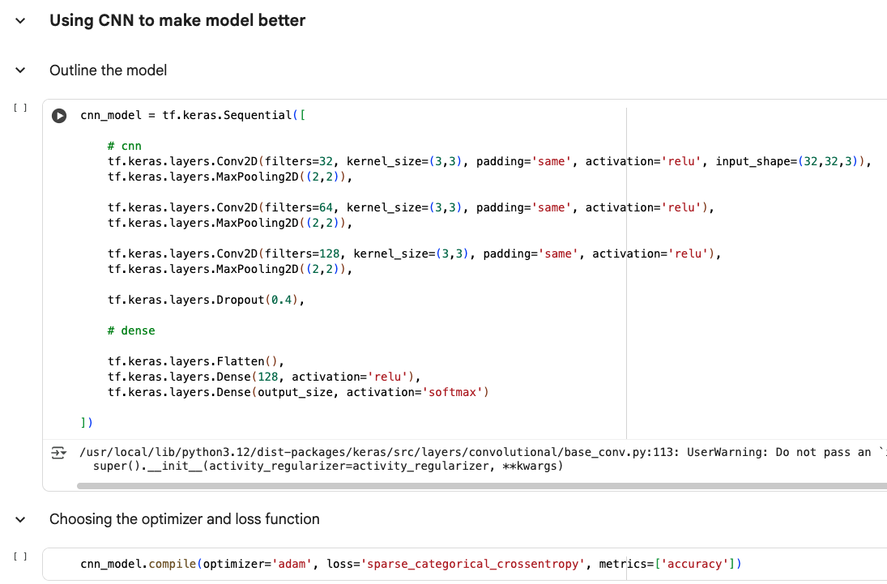
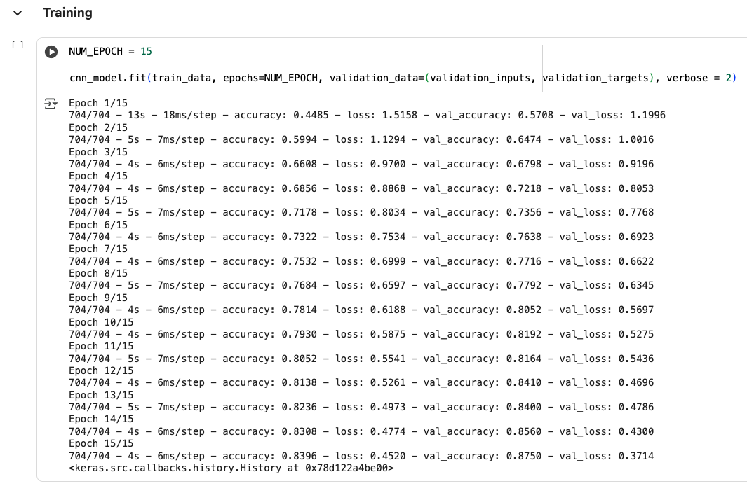
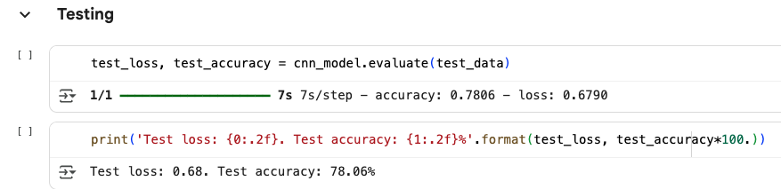
CNN Model Appendix

Slide 14
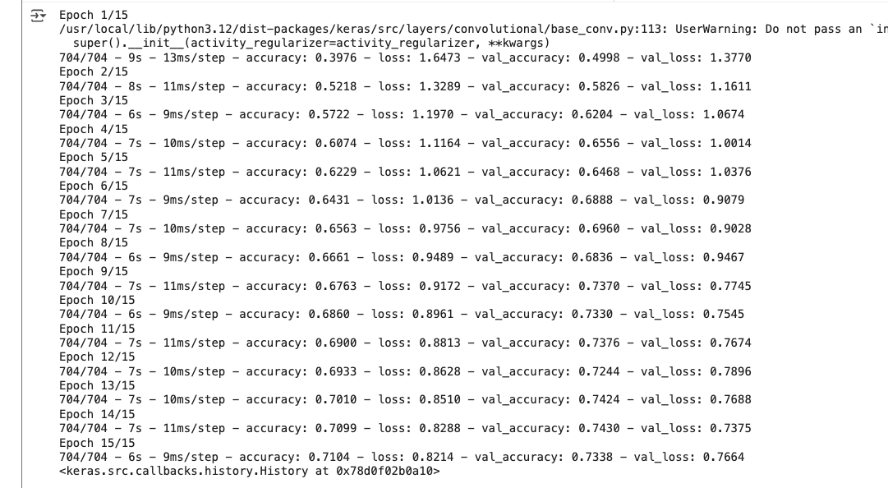
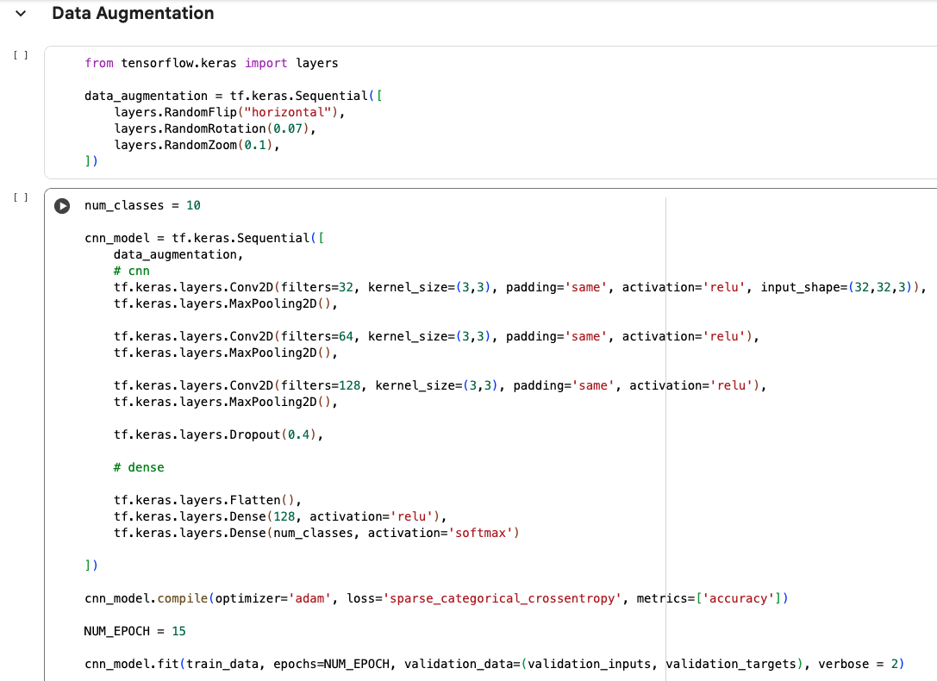
Data Augmentation on CNN Model Appendix

Slide 15
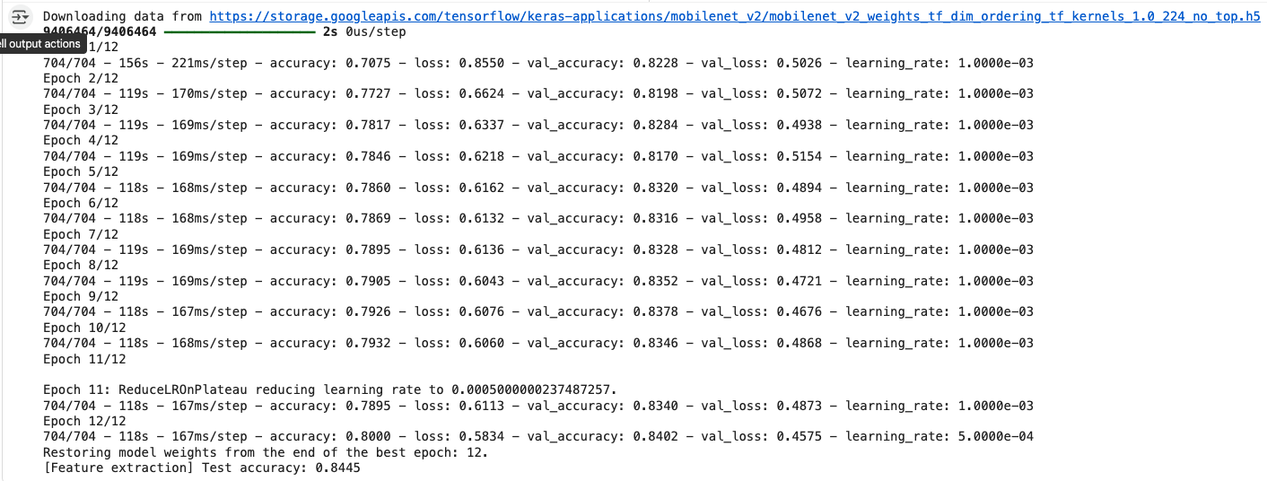
Transfer Learning Appendix

Slide 16
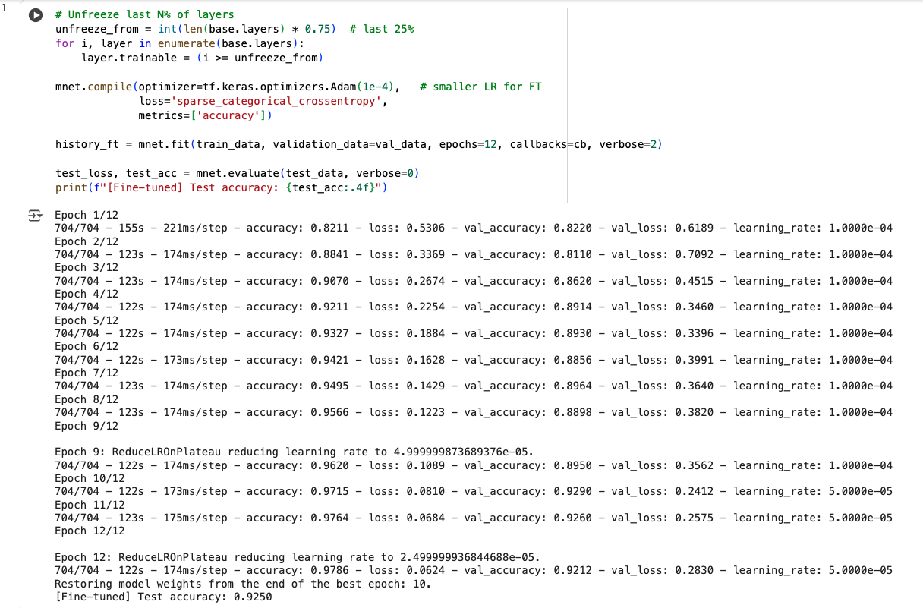
Transfer Learning – Fine Tuning Appendix

